Slide 1
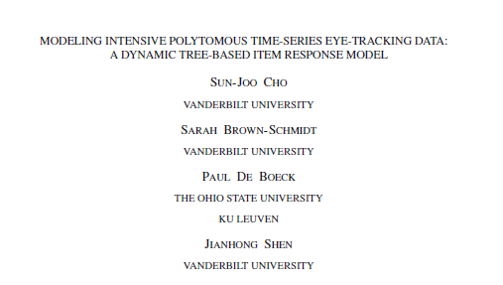
VA Aphasia Lab Dose Response 2, Aim b journal review
Created in Rstudio by AMS

Slide 2
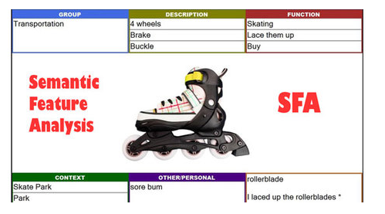
Reminder
Dose Response 2 (DR2):
Participants receive two 2-hour sessions per day of semantic feature analysis (Coelho et al., 2000) for three weeks.
Each participant has three individualized lists of treatment stimuli.
Treated
Semantically related, but untreated
Semantically unrelated and untreated
Aim 1 examines treatment related change while investigating if the number of features generated for each trial moderate participant response to treatment.
Aim 2: Investigates how lexical-semantic processing is affected by intensive SFA (also lexical phonology) using Visual World Paradigms (VWP)
Aim 3: Neural correlates of treatment related change etc.
(Michelle et al., 2018)

Slide 3


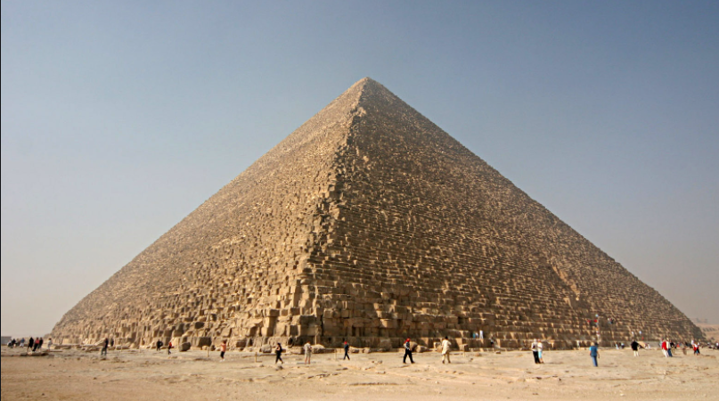

VWP

Slide 4
VWP

Slide 5
VWP

Slide 6
VWP

Slide 7
Why eye tracking
Location data can be nominally coded based on where an individual is fixating.
Fixation areas of interest can then be coded
Binary: correct/incorrect
Polytomous: Correct at the time, but maybe not correct later.

Slide 8

How to code time series data collected through VWP
In time series data…
Binary coding aims to identify and analyze visual attention to a single area of interest.
Polytomous data aims to understand the visual attention given several competing options that are hypothesized to be associated with different cognitive processes.
(Cho et al., 2018)

Slide 9
What’s the point, Cho et al (2020)?
Attempt to model the relationship between multiple cognitive processes with one or more competing response options.

Slide 10
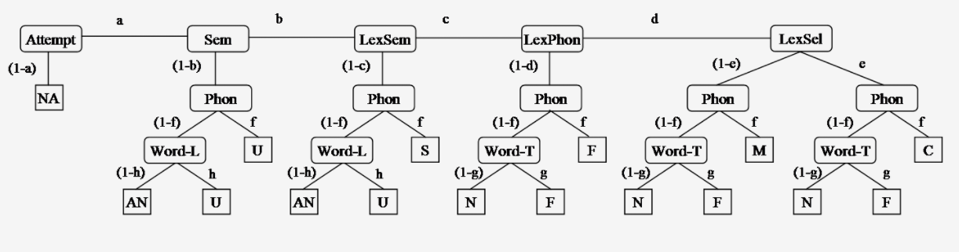
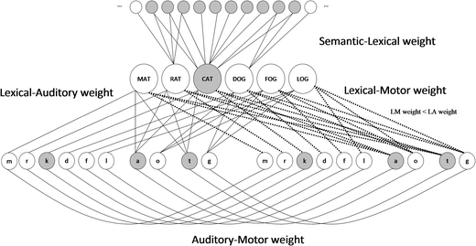
Why gaze?
Gaze is probabilistically directed to individual fixation locations
Location driven by several competing cognitive processes.
Competition:
The semantic–lexical–auditory–motor model (SLAM)
Probabilistic:
MPT model of word production including various error types and response
(Walker & Hickok, 2016)
(Walker et al., 2018)

Slide 11
Analysis types
Generalized linear model (GLM) variants that include time series data:
Dynamic GLM (DGLM)
State space models
Generalized linear mixed effects model (GLMM)
What does dynamic mean?
Cho et al report that a dynamic model accounts for processes including trend and/or serial autocorrelation
Autocorrelation: correlation between elements in a series separated by a defined time interval. See equation 1

Slide 12
GLMM
Require item and person level random effects to reduce bias (no biggie)
Literature has historically lacked a GLMM that also models item effects along with the heterogeneity in autocorrelation (Cho et al., 2018)
Although autocorrelation has been integrated in to the GLMMs described, eye tracking data has yet to be integrated into a model with level changes AND an autoregressive covariate.

Slide 13
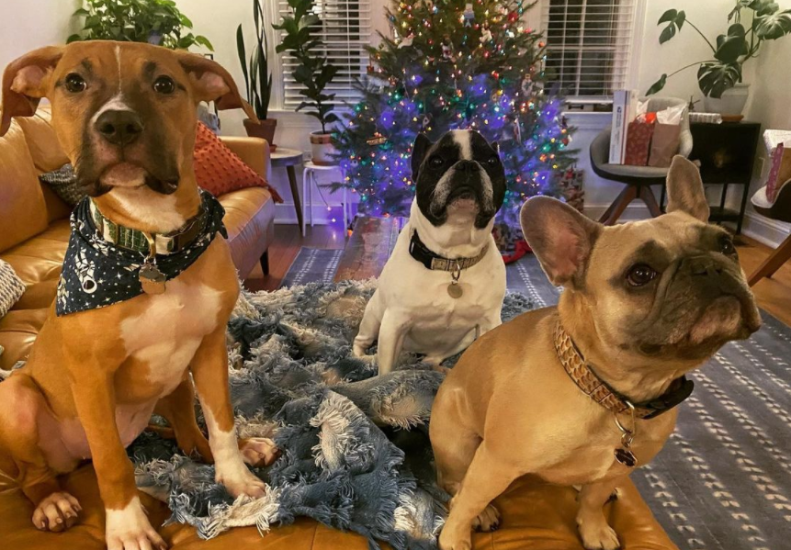
You down with MPT?
With autoregressive covariates, maybe?
Yeah, you know me!

Slide 14
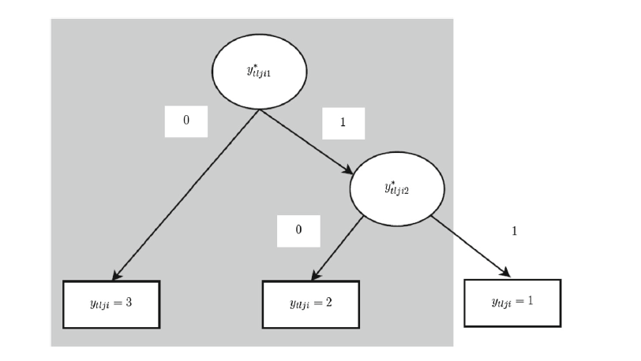
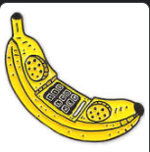

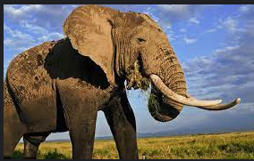
Multinomial processing tree
Nodes: Blue spheres
Branches: Red lines
Leaves: Black rectangle
y fixation index
t time point
l trial
j person
i item
banana
Big envelope
Big elephant

Slide 15
Although MPT models are not new…
The novelty of the proposed model comes from three features:
Tree structure: Differential processing depending on response option
Permitting heterogeneity of processes, nestled well within the Item Response theory framework
Change processes as included in time series models (autocorrelation covariates)

Slide 16
Cho et al data:
Example data examines how listener's interpret instructions
“Click on the small elephant”
Only includes comprehension side of the experiment
n = 152
n trials = 288 total, 96 filler, 96 production, 96 comprehension
Only comprehension included in this analysis
Final n trials = 96
Total observations include din final model: 8886
152 obs * 96 trials = 14,592
8886 were comprehension
Remaining were production
Task: click on the item
Notes:
Lexico-semantic narrows the set of candidate based on a referent

Slide 17

Data wrangling
Fixation time (t = time in ms)
5 > t < 10, t = 10
5 < t, t = 0
Non-fixation events (blinks and saccades) were treated in the same way
Assigning the duration of blink or saccade to the next object that was fixated

Slide 18
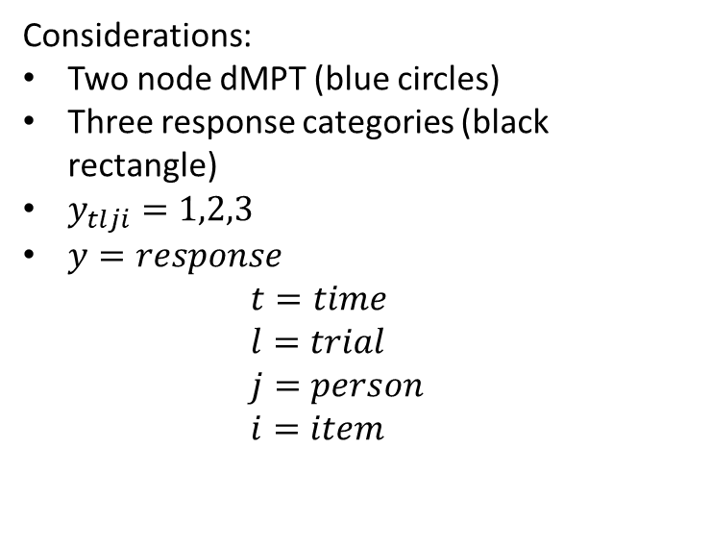
Structure of Cho et al dynamic MPT
Considerations:
Two node dMPT (blue circles)
Three response categories (black rectangle)
$y_{tlji}=1,2,3$
$y=response$ $t=time$ $l=trial$ $j=person$ $i=item$
Nodes: Blue spheres
Branches: Red lines
Leaves/terminal nodes: Black rectangle
Notes:
Rectangles represent observed polytomous responses $y_{tlji}$
For time t, trial l, and person j, and item i

Slide 19
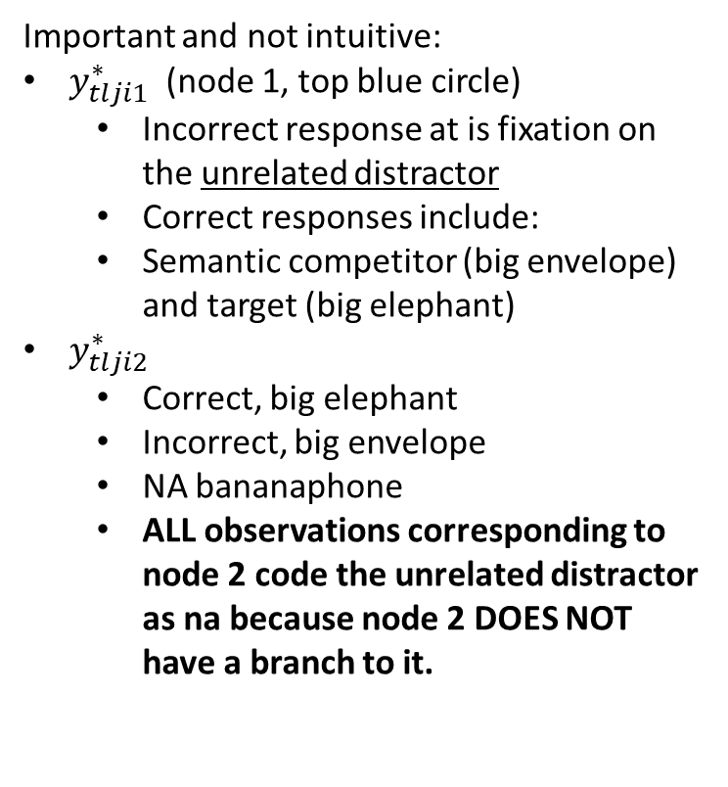
Multinomial processing tree
Important and not intuitive:
$y_{tlji1}^{∗}$ (node 1, top blue circle)
Incorrect response at is fixation on the unrelated distractor
Correct responses include:
Semantic competitor (big envelope) and target (big elephant)
$y_{tlji2}^{∗}$
Correct, big elephant
Incorrect, big envelope
NA bananaphone
ALL observations corresponding to node 2 code the unrelated distractor as na because node 2 DOES NOT have a branch to it.
banana
Big envelope
Big elephant

Slide 20
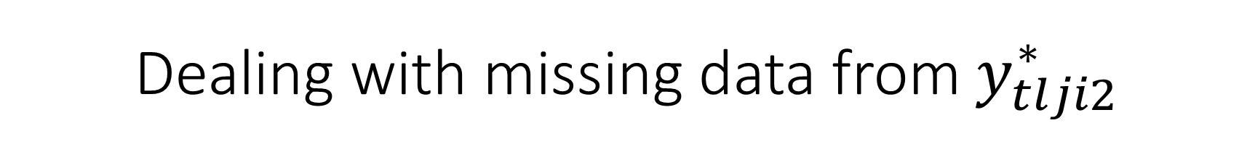
Dealing with missing data from $y_{tlji2}^{∗}$
This data is missing at random
Missingness has to do with the person, but can predicted from other info.
It should not bias parameter estimates
This becomes problematic for node 2 estimation of autocorrelation because after the data is removed.
Next step, y variable then autocorrelation.

Slide 21
Multinomial processing tree
Response | Node r | Ytlji | Y*tljir
Target | 1 | 1 | 1
Semantic Competitor | 1 | 2 | 1
Unrelated Competitor | 1 | 3 | 0
Target | 2 | 1 | 1
Semantic Competitor | 2 | 2 | 0
Unrelated Competitor | 2 | 3 | NA

Slide 22
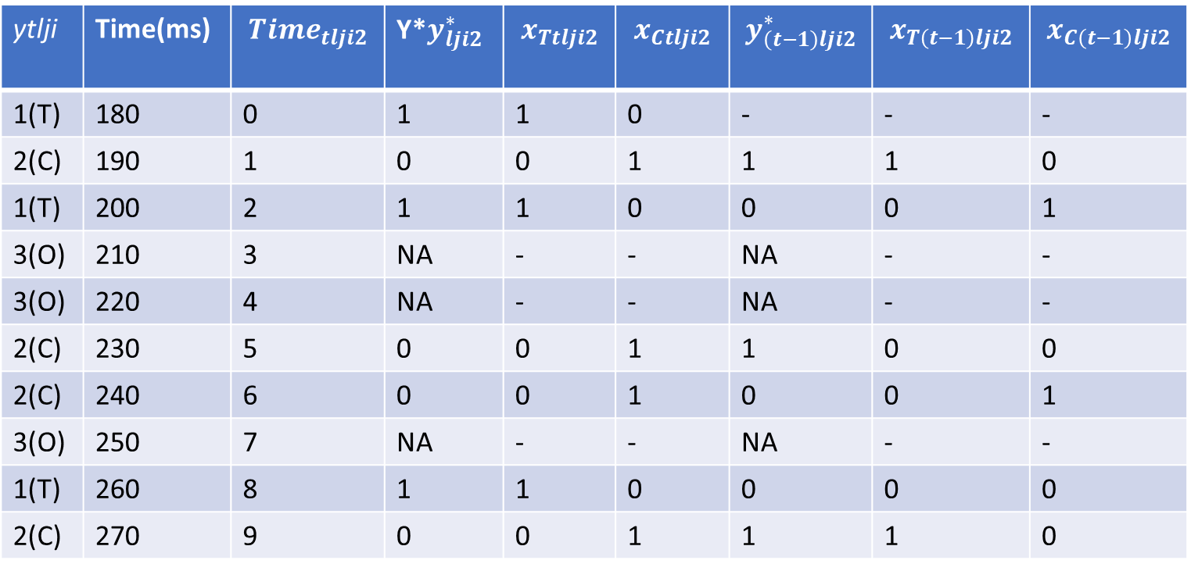
Autocorrelation* *No missing data for AR, except for time point 1
ytlji | Time(ms) | $${Time}_{tlji2}$$ | Y*$y_{lji2}^{∗}$ | $$x_{Ttlji2}$$ | $$x_{Ctlji2}$$ | $$y_{\left(t−1\right)lji2}^{∗}$$ | $$x_{T\left(t−1\right)lji2}$$ | $$x_{C\left(t−1\right)lji2}$$
1(T) | 180 | 0 | 1 | 1 | 0 | - | - | -
2(C) | 190 | 1 | 0 | 0 | 1 | 1 | 1 | 0
1(T) | 200 | 2 | 1 | 1 | 0 | 0 | 0 | 1
3(O) | 210 | 3 | NA | - | - | NA | - | -
3(O) | 220 | 4 | NA | - | - | NA | - | -
2(C) | 230 | 5 | 0 | 0 | 1 | 1 | 0 | 0
2(C) | 240 | 6 | 0 | 0 | 1 | 0 | 0 | 1
3(O) | 250 | 7 | NA | - | - | NA | - | -
1(T) | 260 | 8 | 1 | 1 | 0 | 0 | 0 | 0
2(C) | 270 | 9 | 0 | 0 | 1 | 1 | 1 | 0
Notes:
Y*$y_{lji2}^{∗}$ includes 1 when participant is looking at the correct location 1 (big elephant) 0 lexico-semantic competitor 0. Unrelated distractor NA. This was shown on the last slide.
XTlji2, corresponds to 1 only if participant is looking at a target or a scorable competitor
XCTLJI2 shows the lag covariate of a correct response.
Y*(t-1_lji2 shows whether the participant was looking at the target at the previous time step.
XT(t-1)lji2 shows whether the participant was looking at the target at the previous time step
XC(t-1)lji2 shows whether the participant was looking at the participant was looking at the competitor at the previous time step.

Slide 23
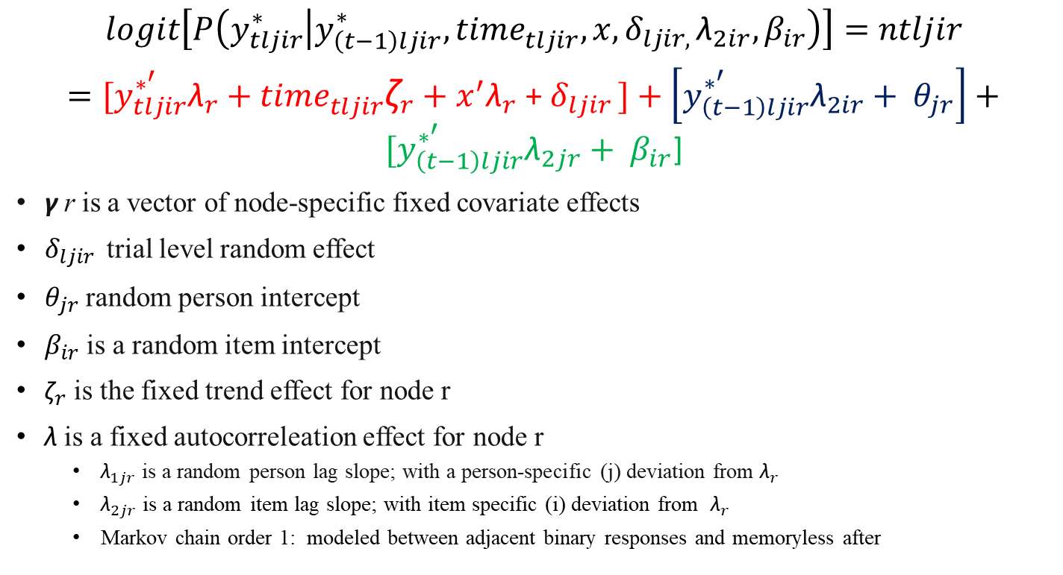
Structure of Cho et al dynamic MPT
$$logit\left[P\left(y_{tljir}^{∗} | y_{\left(t−1\right)ljir}^{∗}, {time}_{tljir}^{}, x, δ_{ljir, }{\text{λ}}_{2ir}, β_{ir}\right)\right]=ntljir$$ $=[y_{tljir}^{∗^{′}}{\text{λ}}_{r}+$ ${time}_{tljir}^{}{\text{ζ}}_{r}+x^{′}{\text{λ}}_{r}$ + $δ_{ljir }]+\left[y_{\left(t−1\right)ljir}^{∗^{′}}{\text{λ}}_{2ir}+ θ_{jr}\right]+$ $[y_{\left(t−1\right)ljir}^{∗^{′}}{\text{λ}}_{2jr}+ β_{ir}$]
γ r is a vector of node-specific fixed covariate effects
$δ_{ljir }$ trial level random effect
$θ_{jr}$ random person intercept
$β_{ir}$ is a random item intercept
${\text{ζ}}_{r}$ is the fixed trend effect for node r
$\text{λ}$ is a fixed autocorreleation effect for node r
${\text{λ}}_{1jr}$ is a random person lag slope; with a person-specific (j) deviation from ${\text{λ}}_{r}$
${\text{λ}}_{2jr}$ is a random item lag slope; with item specific (i) deviation from ${\text{λ}}_{r}$
Markov chain order 1: modeled between adjacent binary responses and memoryless after
Fixed effects
Random person effects
Random item effects
The probability of a fixation
Notes:
(zeta) ζr is a fixed trend effect for node r . This trend parameter reflects whether or not there is a trend over time in the fixation data.

Slide 24
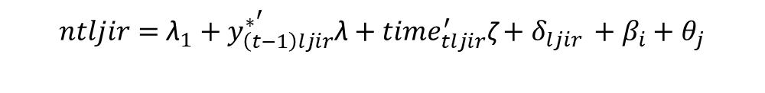
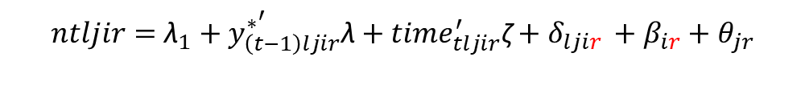
Assessing if a single latent variable underlies the cognitive process at each node
Unidimensional model drops the node by trial, person, and item effect
$ntljir={\text{λ}}_{1}+y_{\left(t−1\right)ljir}^{∗^{′}}\text{λ}+{time}_{tljir}^{′}\text{ζ}+δ_{ljir }$ + $β_{i}$ + $θ_{j}$
$ntljir={\text{λ}}_{1}+x_{T\left(t−1\right)ljir}^{′}{\text{λ}}_{Tr}+x_{C\left(t−1\right)ljir}^{′}{\text{λ}}_{Cr+ }{time}_{tljir}^{′}\text{ζ}+δ_{lji }$ + $β_{i}$ + $θ_{j}$
Multidimensional accounts for node-specific parameters
$ntljir={\text{λ}}_{1}+y_{\left(t−1\right)ljir}^{∗^{′}}\text{λ}+{time}_{tljir}^{′}\text{ζ}+δ_{ljir }$ + $β_{ir}$ + $θ_{jr}$
$ntljir={\text{λ}}_{1}+x_{T\left(t−1\right)ljir}^{′}{\text{λ}}_{Tr}+x_{C\left(t−1\right)ljir}^{′}{\text{λ}}_{Cr+ }{time}_{tljir}^{′}\text{ζ}+δ_{ljir }$ + $β_{ir}$ + $θ_{jr}$
After selection, assess if random lag slopes are needed to account for person and item heterogeneity

Slide 25
Model selection
Convergence
AIC
BIC
One final model is selected, add in experimental covariates of interest
Notes:
Aic selects model with lowest mean squared error
BIC

Slide 26
Data wrangling
df2 = df2 %>%
mutate(y = na_if(y_5, 0)) %>%
fill(y, .direction = "up")

Slide 27
Coding trend and autocorrelation
20ms bins
time is mean centered by trial, person, and item
Lag covariates were created for unique combination of trial, person and item.
Deviant coded (-1,1)
Allows for comparison mean of the dependent variable for a given level to the overall mean of the dependent variable

Slide 28
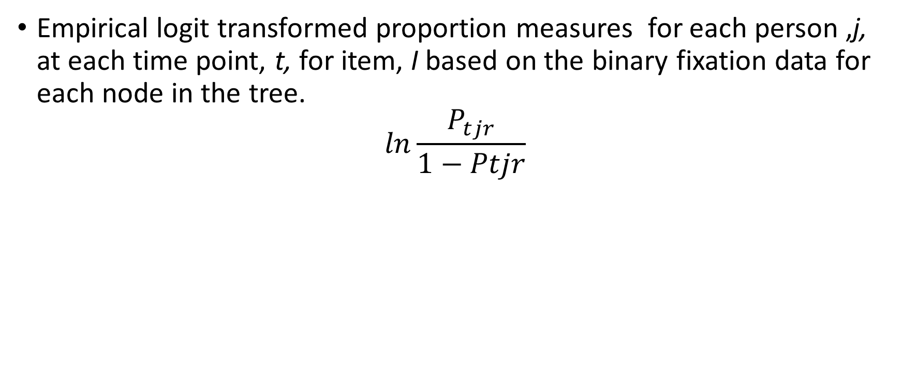
Coding outcome measure y
Empirical logit transformed proportion measures for each person ,j, at each time point, t, for item, I based on the binary fixation data for each node in the tree.
$$ln\frac{P_{tjr}}{1−Ptjr}$$

Slide 29
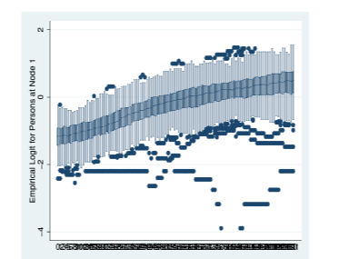
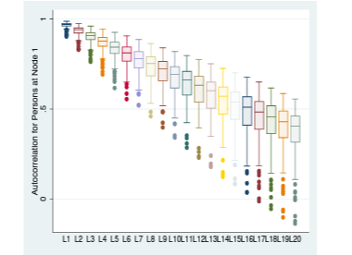
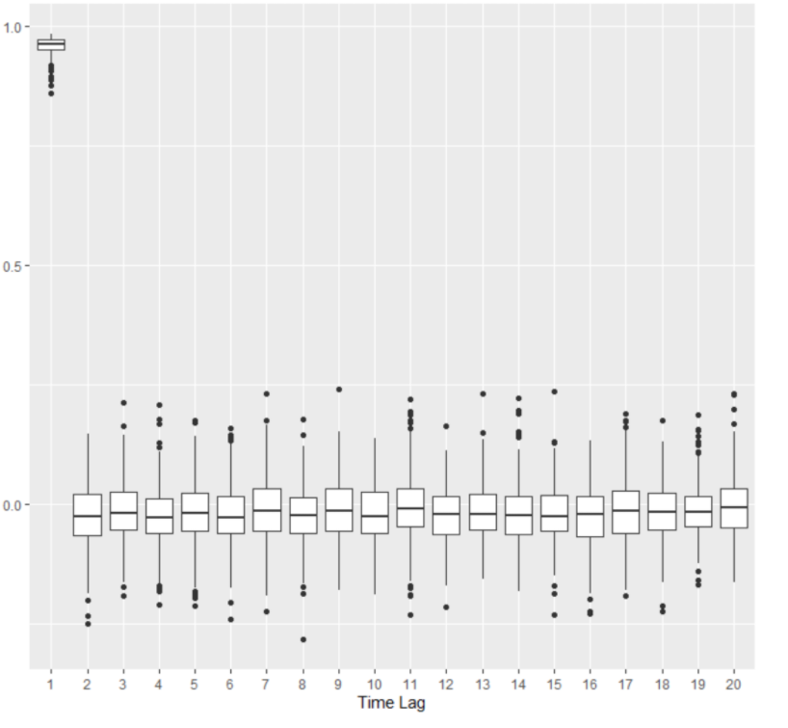
Should autocorrelation and partial autocorrelations be included in your model?
Characterizing change processes in time series data
Autocorrelation
Partial autocorrelation
Trend
Notes:
Autocorrelation DOES NOT CONVERGE AT ZERO and therefore must be accounted for in the model
Can compare autocorrelation estimates across trials, persons, and items with linear growth models to assess the need for random intercepts across participants.

Slide 30
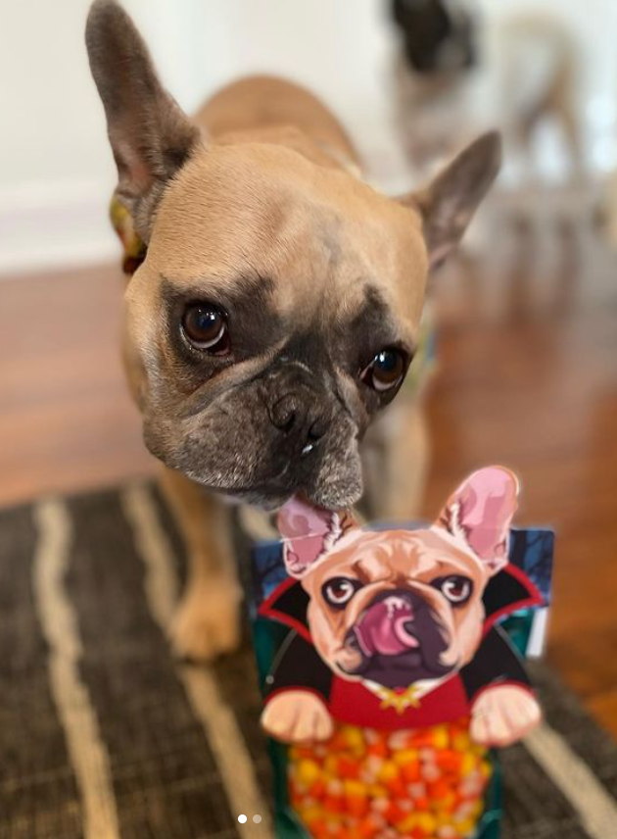
Experimental conditions:
What about the experimental conditions?
1 contrast: item can be identified with just the first word (adjective)
2 contrast: requires adjective and noun
Contains privileged and shared conditions.
Helmert coded as -1, .5, -.5
Conditions

Slide 31
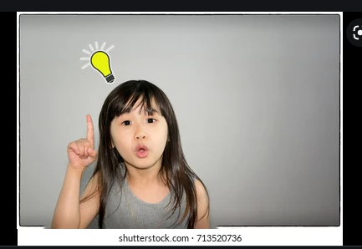
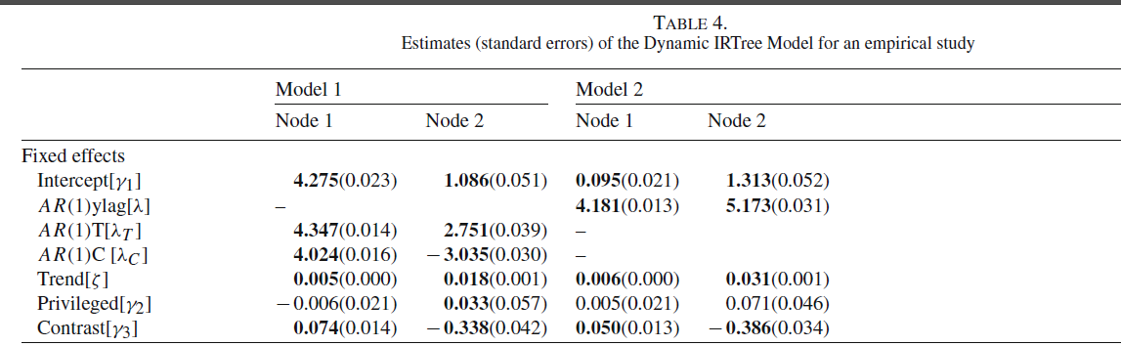
Results
Notes:
Contrast covariate: compares the one contrast condition to the two contrast conditions. A significant effect of the first contrast covariate at Node 1 is due to more looks at the target and competitor in the two contrast conditions (participant must disambiguoate).
This effect was negative at node 2 and is a result of more looks at the target than competitors in the one contrast condition compared to the twso contrast conditions. This is likely because the one contrast condition clearly identified the target with activating competitor information.
The privileged condition compares the two, two condition contrats. Let’s not dig into this result.
Interpretation: AR was significant at node 1 and node 2. This effect size is interpreted such that there are strong carry over effe cts from a target or competitor at time t-1to target or comepetitor at tie point 21.

Slide 32
Is modeling autocorrelation and trend necessary?
Simulation study
Removing the trend fixed effect and the autocorrelation random effect results in increased RMSE.

Slide 33
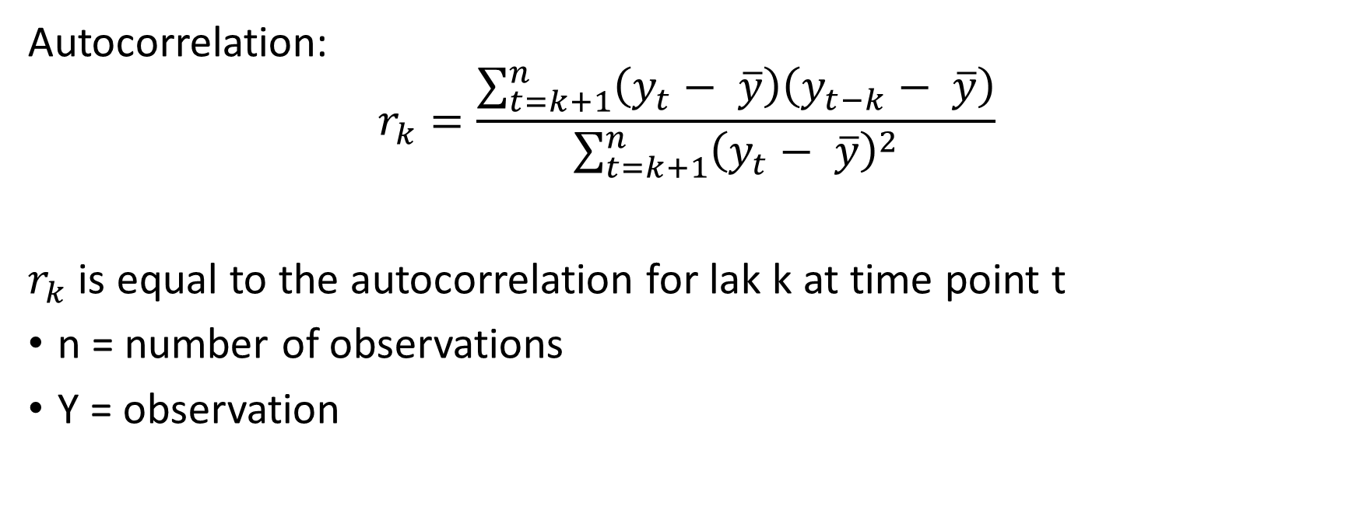
Equations
Autocorrelation:
$$r_{k}=\frac{\sum_{t=k+1}^{n}{\left(y_{t}− \overline{y}\right)\left(y_{t−k}− \overline{y}\right)}}{\sum_{t=k+1}^{n}{{\left(y_{t}− \overline{y}\right)}^{2}}}$$
$r_{k}$ is equal to the autocorrelation for lak k at time point t
n = number of observations
Y = observation

Slide 34
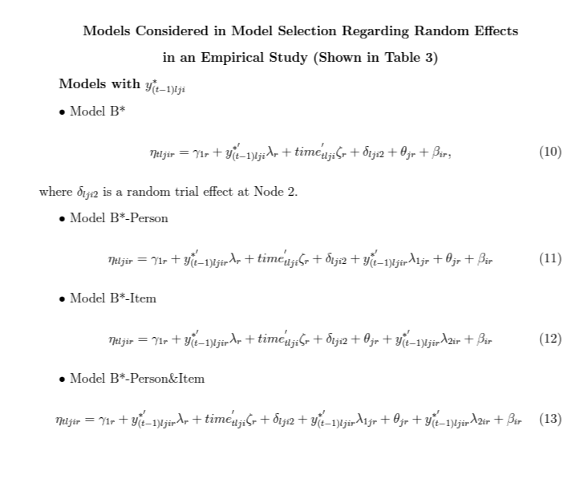
Equations

